Slide 1
Sorting Algorithms

Slide 2
Bubble Sort
Compare the 1st and 2nd elements of the list
If the 2nd is smaller than the 1st then switch then if not then leave the same
Compare the 2nd and 3rd elements of the list
If the 3rd is smaller then the 2nd then switch them if not then leave them the same

Slide 3
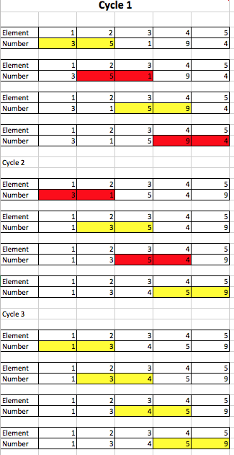
Bubble Sort Diagram

Slide 4
Merge Sort
Write each individual element down the left hand side
Compare the 1st and 2nd elements that are down the side and write them in order just to the right this is now set ‘a’
Compare the 3rd and 4th and write them in order just to the right this is now set ‘b’
Compare the first two elements of set ‘a’ and ‘b’ write them in order, then do the same for the second 2 elements.

Slide 5
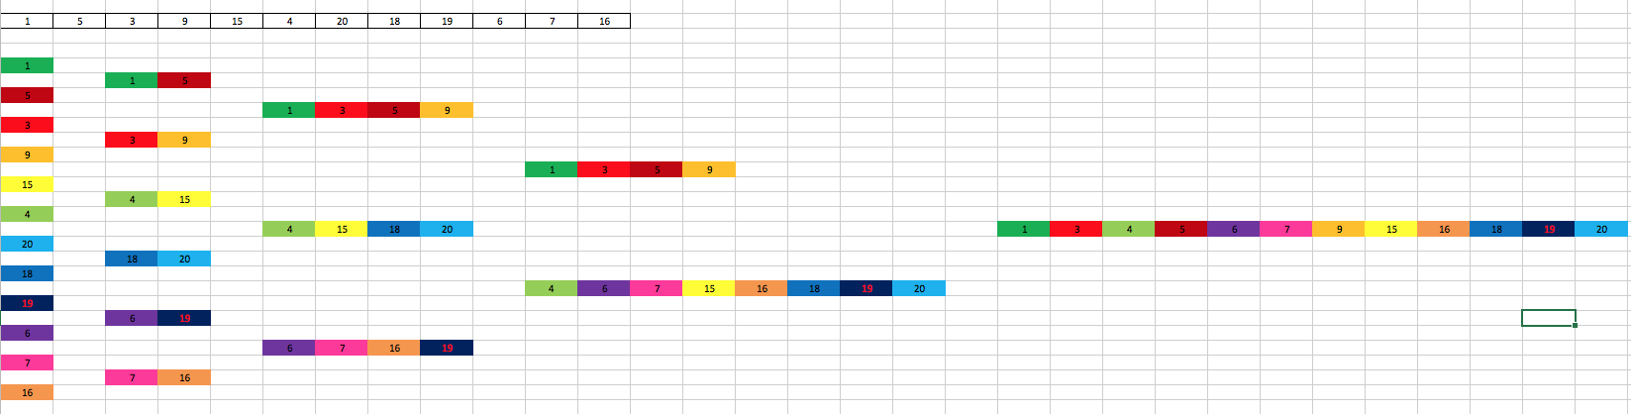
Merge Sort Diagram

Slide 6
Insertion Sort
The Insertion sort is for getting one sorted list from one sorted list and one unsorted list.
Compare the first element in the unsorted list to each element in the sorted
If it is smaller then put it in front of the element that it was smaller than
If not then compare it to the next
When there are no more elements put it at the end of the sorted list
Repeat this process until all the elements of the unsorted list are in the sorted list.

Slide 7
